Slide 1
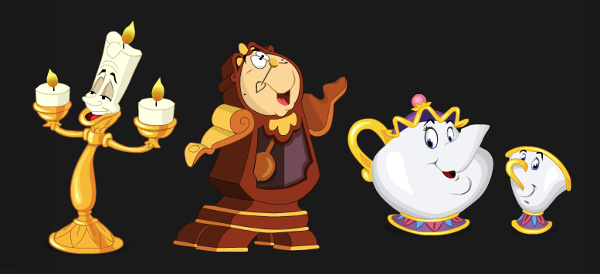
Personification …bringing ordinary objects to life
Elementary PowerPoint created by:
Mrs. Janet Lewandowski
McKnight Elementary School

Slide 2
What is personification?
Personification is giving human characteristics to something that is not human.
Writers use personification to make their writing more interesting.

Slide 3
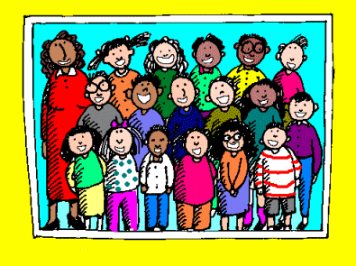
What can humans do?
sing dance whisper run sob
laugh think
jump crawl
Can you think of more verbs that humans can do?

Slide 4
Examples of Personification
My iPod sings to me while I work.
An iPod is an object. It cannot “sing,” but people may hear music coming from it.

Slide 5
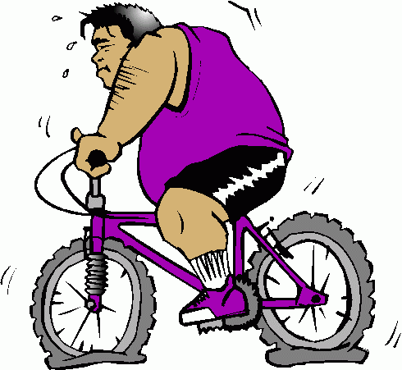
The bicycle moaned when the man sat on it.
A bicycle is an object. It cannot “moan,” but it may creak or leak air when someone sits on it.

Slide 6
My stomach screamed for food.
A stomach is an object. It cannot “scream,” but noises may be heard coming from it if a person is hungry.
Please feed me!!!

Slide 7
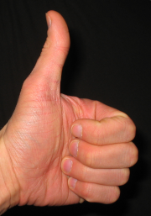
Is this personification?
When I say, “Show me,” put:
---two thumbs up for YES
or
--two thumbs down for NO.

Slide 8
The car engine coughed and sputtered before it started.
Think…
SHOW ME
Yes!
A car engine cannot “cough,” but it can sound noisy if it is having difficulty starting.

Slide 9
The video camera observed each scene of the play.
Think…
SHOW ME
Yes!
A video camera does not have eyes. It cannot “observe,” but it can record the images in front of it.

Slide 10
The boy is riding a red and black scooter across the street.
Think…
SHOW ME
No!
The boy is human, and humans really can ride a scooter.

Slide 11
The cool rain kissed my cheeks as it fell against my warm face.
Think…
SHOW ME
Yes!
Rain does not have lips and cannot kiss. The rain landed on this person’s face.

Slide 12
The colorful toys were neatly stacked on three long shelves.
Think…
SHOW ME
No!
The toys are not acting like humans. A human stacked them on the shelves.

Slide 13
It’s your turn…
Use personification to describe autumn leaves falling from a tree.
Remember to include at least one verb that describes something humans can do.
Finish this sentence:
The leaves ___________ off of the tall tree and _____________ to the ground.

Slide 14
…So the next time a good book is “calling” you to read it, try to find some examples of personification.
…Add examples of personification in your writing to make it more interesting. Before you know it, the personification examples will be
“jumping”
out of your head and onto the paper!
Read me!

